Slide 1
FOODAHOLIC Find – Discovery - Share
LÂM VŨ HẰNG – 16T3 – MSSV: 102160138

Slide 2



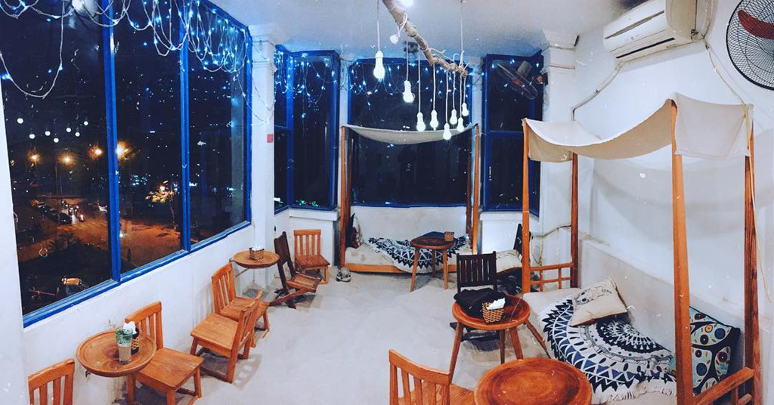


FOODAHOLIC

Slide 3
INTRODUCE
Nowadays, the food demand of human being is increasing. In addition, the development of technology that leads to the necessity of creating a app which helps customers to look for the information of restaurants . However, instead of searching for the various websites of each restaurant to find the service you want, now users can use only one app that can help us find out all the needed information. The created app is responsible for updating, synthesizing, and containing as much information as possible. It’s called FOODAHOLIC.

Slide 4
MAIN FUNCTION
1.Classify restaurants by location: The function allows users to filter places to search by city area, district, near area ... Google Maps integration site can help users to find the way to that restaurant.
2.Category classification: This app can list restaurant’s name follow the type of foods or drinks
3.Review / Comment: The review function allows users to submit a 1-5 star rating for any service on the application, the users can comment and add the photos

Slide 5
MAIN FUNCTION
5.Reservation tools: Users can book table by hour or make reservation immediately. You can do it by using a personal signed account
6.Discount Code: Showing some special discounts for the customers when using the app
7.Home delivery: depending on the distance ,the restaurant will support free or charged delivery for the customers.

Slide 6
INNOVATION
Especially, this app not only allows the big restaurant to do the PR but also helps customers provide the suggestions for other customers about a good restaurant, insprite of small shops, local shops which open in particular time frameThis is a completely new function compared to the similar applications created before.
So, the question is if you are in the position of a customer signing an account to look for restaurant information, how can you give suggestions to another customers, and how can another customers see your suggestions.

Slide 7
HOW TO SOLVE
Customers can propose through the chat box with the admins if they are directly on the website , or suggest by mailbox or function tab if using the app on the mobile
The admin will record the places are proposed by user , with a certain number of proposals, there will be censorship and verification information. If the result is exactly the same as the information provided by the user, the palces will be added to the system.

